Slide 1
College Cost
Abhishek Prajapati
Dhrumil Shah

Slide 2
About Our Project
Our project allows students to find best colleges in which they have the best chance of getting in and it is affordable to them. We dig through the database to find the best colleges given a specific input such as student’s budget, their sat/act score, etc. and then we build a query based on those information and output the best colleges for the students. That is most affordable to them.

Slide 3
Audience & how does it benefits them
Our audience are students who are recently in high school and planning on going to college., and also for students and people who are trying to know more about college tuition cost.

Slide 4

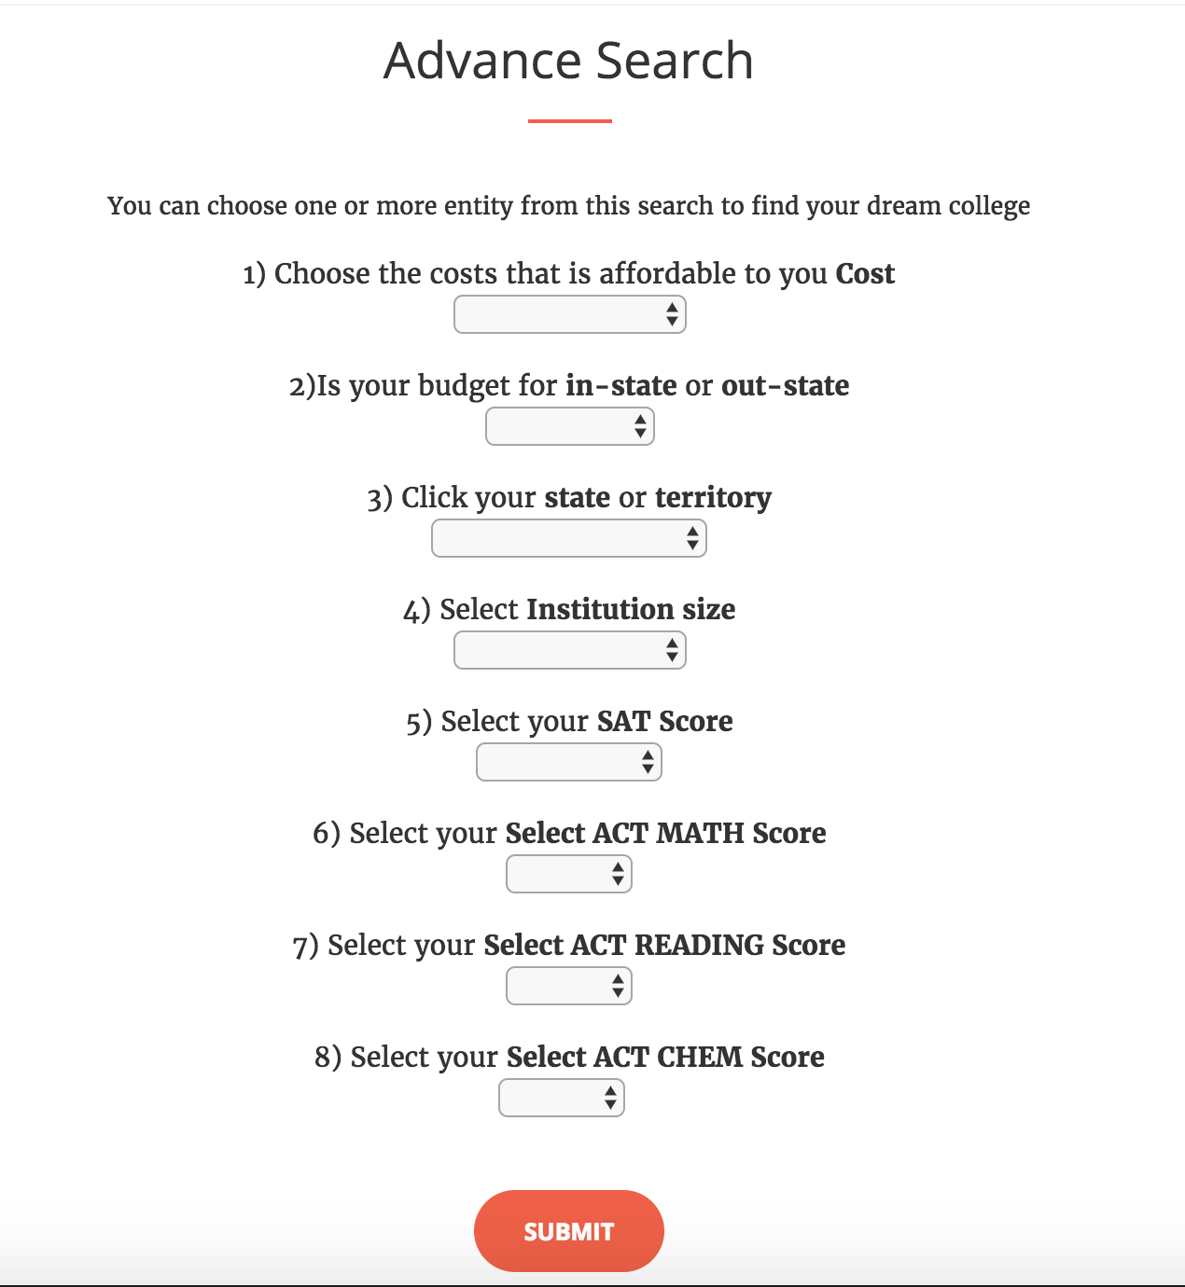
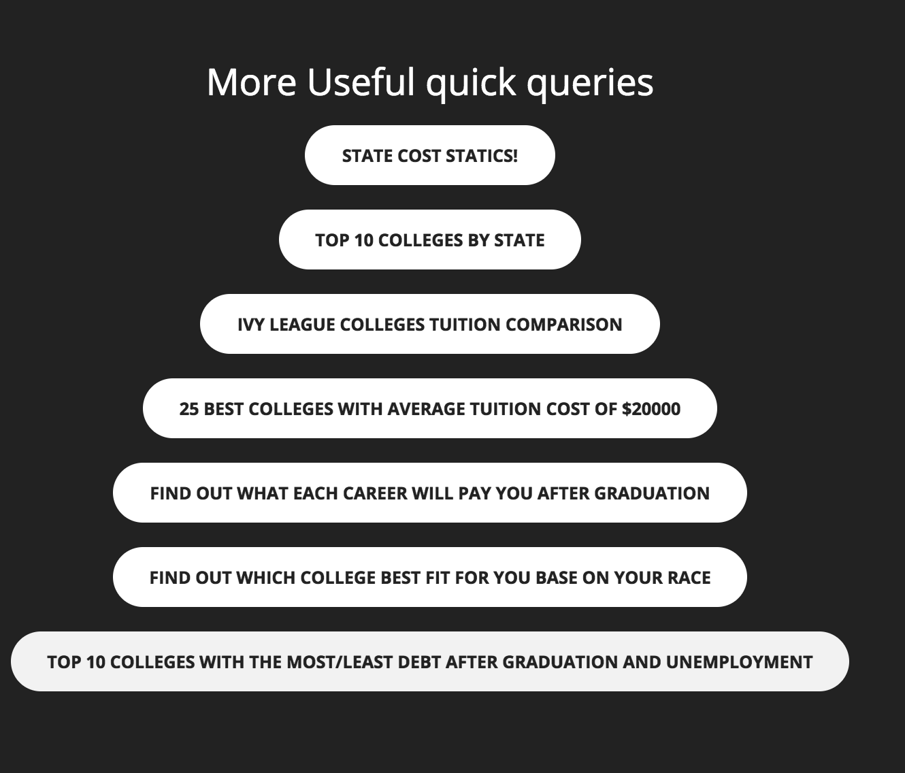
User Input

Slide 5
Functionality
**Note: Default values of 0,1,or null is used if not data were provided by the college, and in advance search if only blank table shows up that means no colleges were found based on your search.
1) we let user search college name. When user enter the college name, we find all the colleges related to user input, then show all the information about that college that user possibly need to know about the college, such as tuition cost, living cost, acceptance rate, Ethnicity ratio, and much more.
2) We ask user for bunch of inputs and build queries based on those inputs so students can find colleges that they have good chance of getting into and affordable to them.
3)We also provide bunch of quick queries where students can quickly find useful information and colleges.

Slide 6
URL
http://sample-env.umm2tmxswa.us-east-2.elasticbeanstalk.com/

